Slide 1
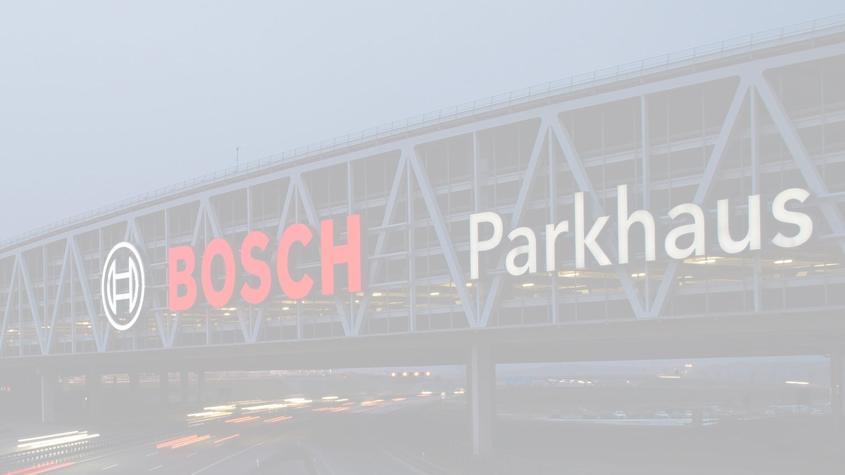
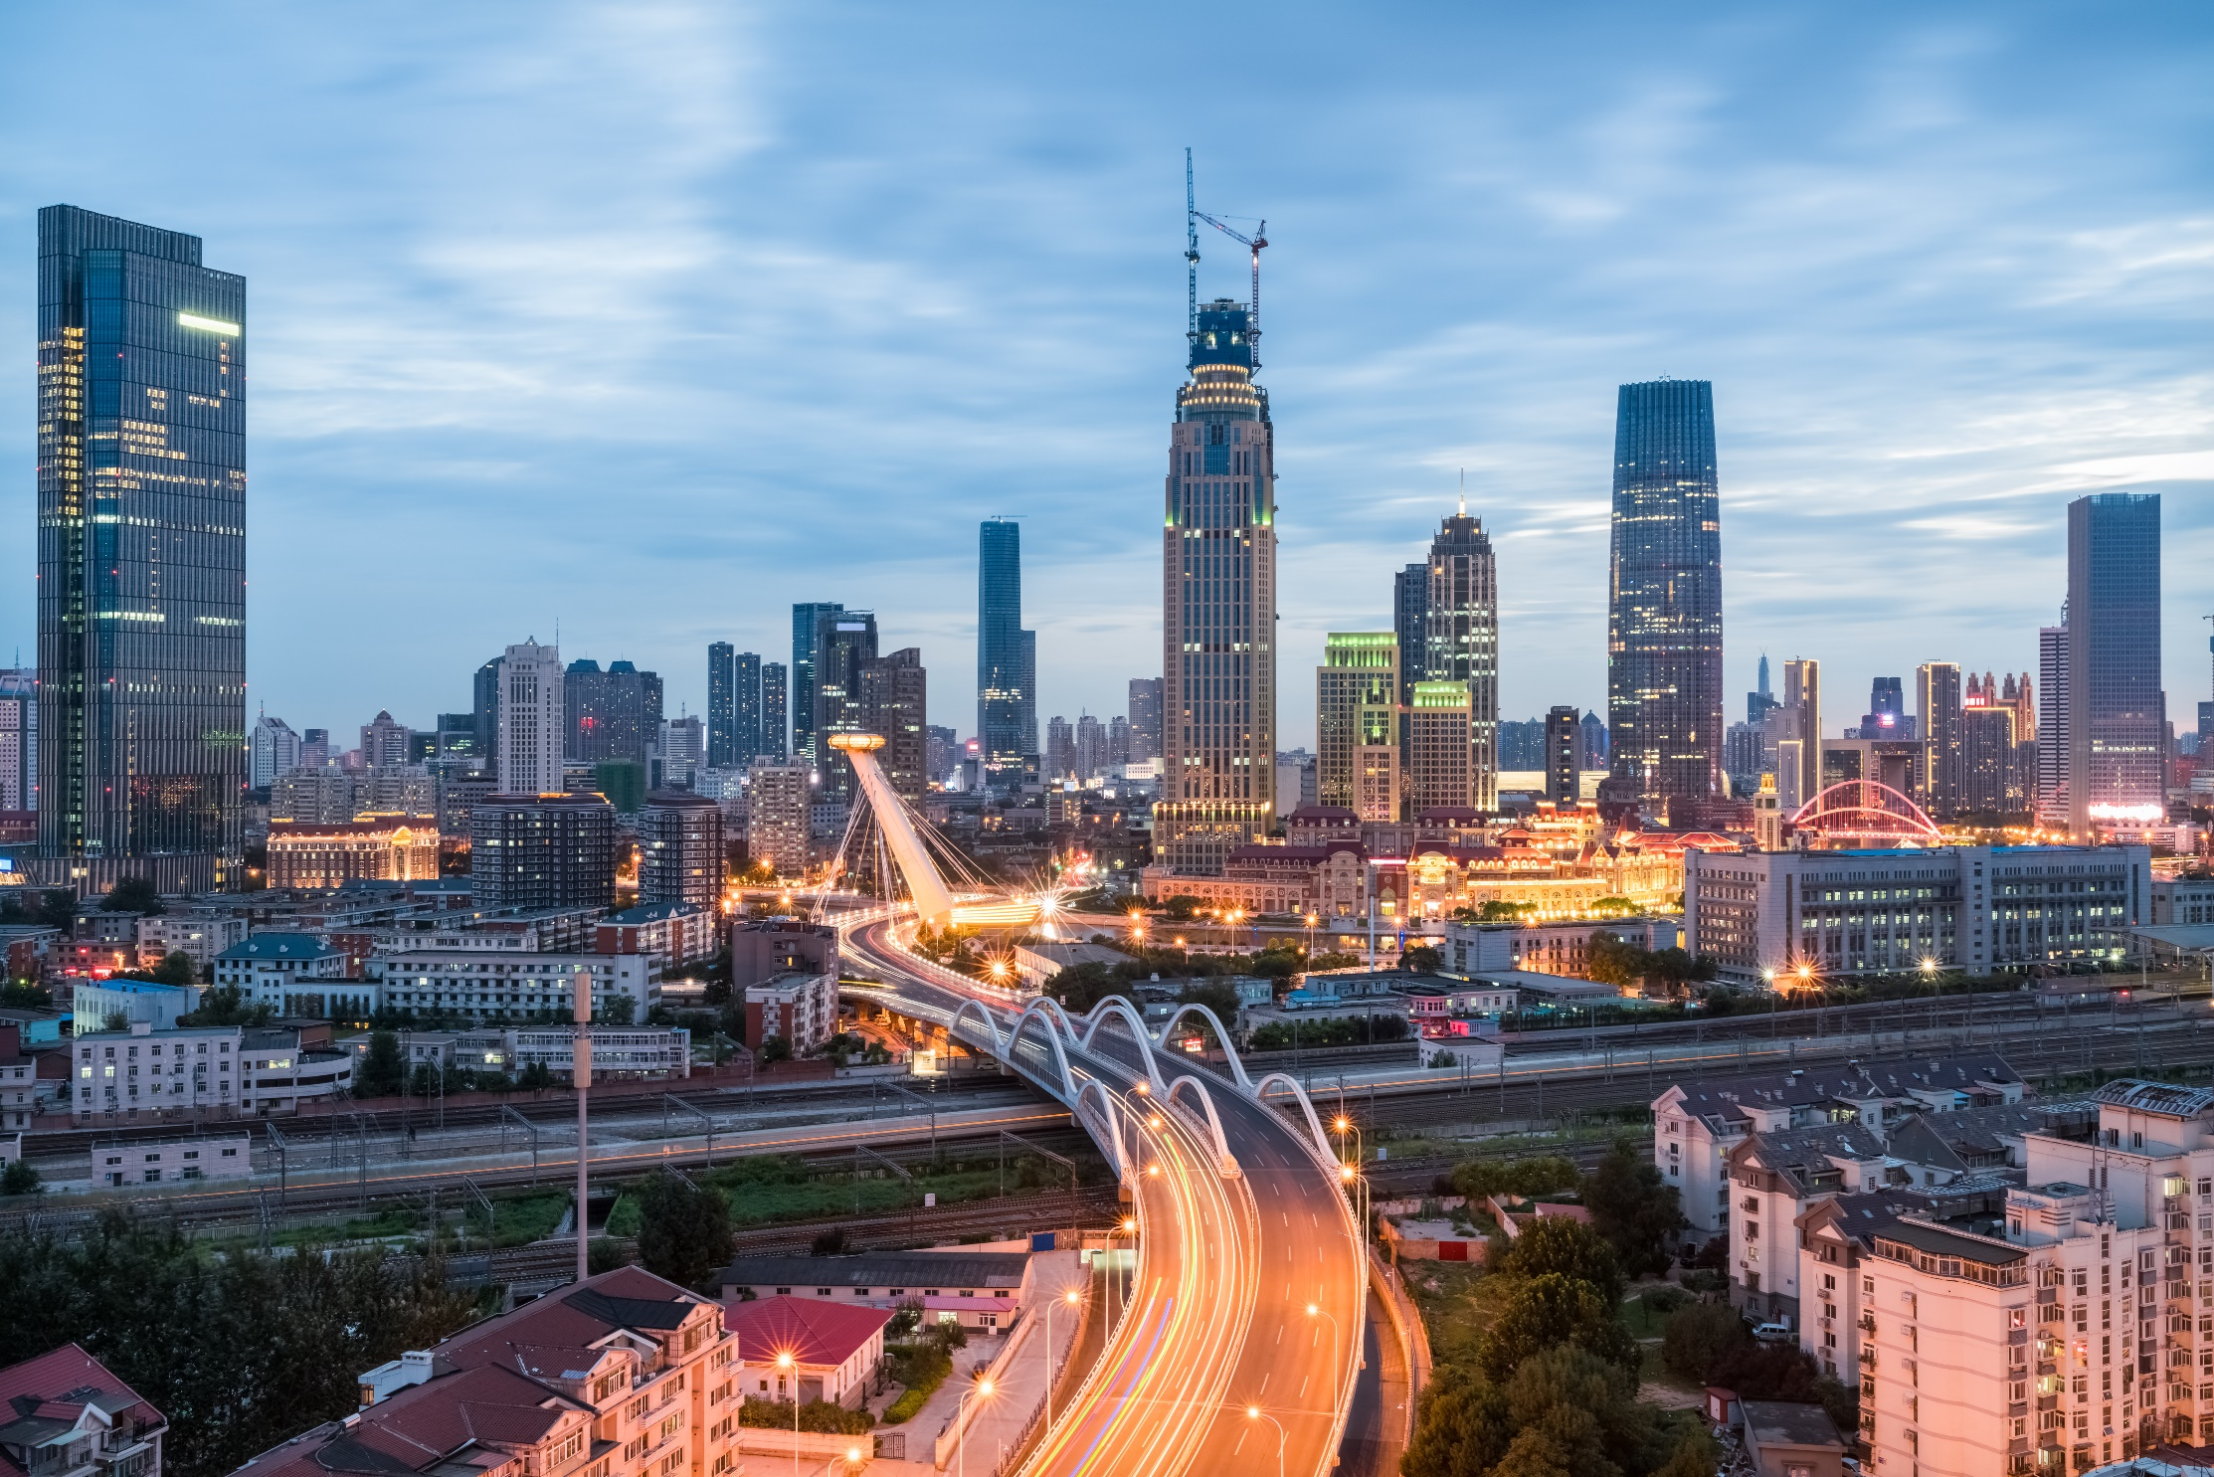
ROBERT BOSCH ENGINEERING AND BUSINESS SOLUTIONS PVT. LTD
Transformation through Sensors, Software and Services
Fascinating technologies for everyday life

Slide 2

Visual Computing for Advanced OCR: Problem Statement
Big Data and Artificial Intelligence
The overall idea behind this project is to:
Develop an computer vision algorithm along with solution package for recognizing and digitizing steps of solving a mathematical equation written by freehand on a paper
Validating the steps and final answer of the recognized handwritten lines by maintaining the context

Slide 3

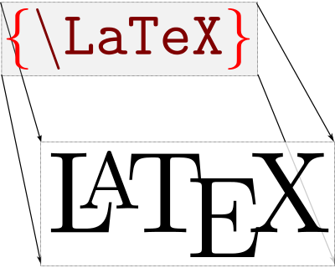
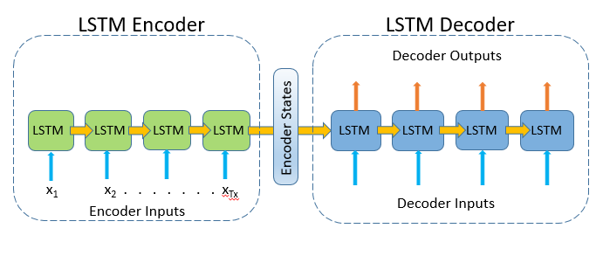
Visual Computing for Advanced OCR: Approaches
Big Data and Artificial Intelligence
1. Using TESSERACT based OCR Deep Learning Model
Tesseract 4 adds a new neural net (LSTM) based OCR engine which is focused on line recognition.
It also has a unique configuration option for detecting equation region in the document.
Note : We may need to retrain the tesseract on handwritten mathematical expressions to improve accuracy
2. Image-to-Markup Generation Latex based Deep Learning Model
Attention based encoder-decoder model to convert images to LaTex
3. Off-Line Math Formula Recognition
Based on Multi-Scale Attention with Dense Encoder for Handwritten Mathematical Expression Recognition uses attention based encoder-decoder.

Slide 4
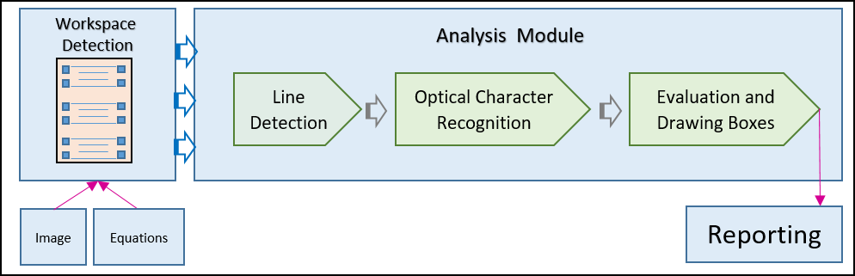
Visual Computing for Advanced OCR: Workflow
Big Data and Artificial Intelligence
Workspace Detection using valid markers in the sheet
Detecting and localizing each single lines
Perform Optical Character Recognition in each detected line
Evaluating each line and Providing feedback in terms of red/green bounding box drawn across it where green represents correct and red represents wrong
Can be merged in a single step based on requirement

Slide 5

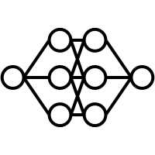
Visual Computing for Advanced OCR: Training and Testing
Big Data and Artificial Intelligence
1. Data Generation
Data Generation will take place in the following two phases :-
Electronic data generation using publicly available digits and symbols datasets
Manually data generation by writing by Bosch employees
2. Training, testing, and Quality
From the complete dataset, 75% data will be used for training, 5% for validation, and 20% for testing.
Confusion matrix will be used for quality estimation

Slide 6
Team at a Glance
Big Data and Artificial Intelligence
Who We Are
What We Do
High impact business use cases improving topline and bottomline
across multiple domains
Centralized team of AI and Machine Learning experts
Operational since 2012
Competencies spanning ML/AI, big data engineering and visualization sciences
We generate value from data captured using field devices and from sensor applications to:
Generate value-add and usefulness in commercial services
Optimize assets, resources, efficiency; & reduce waste

Slide 7
Computer Vision Portfolio - Landscape of Competencies
Big Data and Artificial Intelligence
Image | Video Processing
Machine Learning
Video Analytics
Deep Learning
Computer Vision
Software Engineering
Automotive
Surveillance
Annotation
Industrial Automation
Multimedia Applications
Efficient Annotation
Object Detection
Object Tracking
Object Classification
Scene Understanding
Semantic Segmentation
MATLAB | OCTAVE
Keras|Tensorflow|PyTorch
OpenCV
SciKit
Visualization
01
02
03
04
TOOLS
TECHNOLOGY
DOMAIN
SOLUTIONS

Slide 8

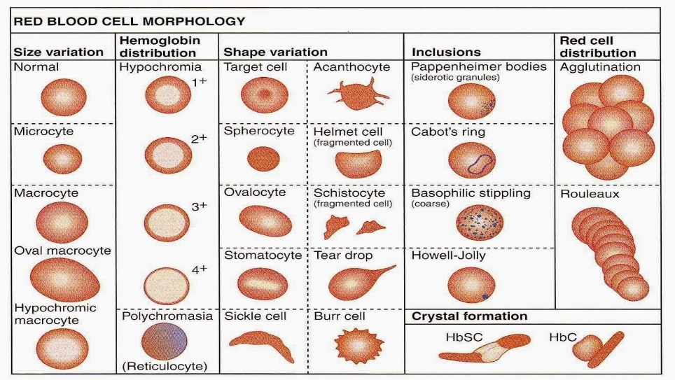

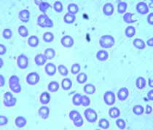

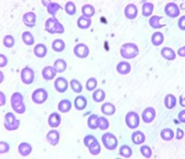

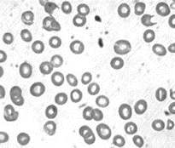


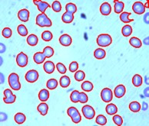
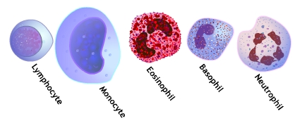



Intelligent image processing, ML based classification
Big Data and Artificial Intelligence
Advanced Image Processing
Key Benefits
Input Image
Manage scale of users
Background Removal
Reduce the demand for experts
Edge Retained
Binary
Reduce manual errors
Contour
Extraction
Improved turn around time
Platelets
Enable digital healthcare
How AI solves this problem?
Analysis of millions of cells are performed at sub-cellular level based on
Size analysis, Morphological analysis, Colour analysis, Textural analysis, Count analysis
where AI plays a vital role by providing standardized and reproducibility of results
Machine Learning and AI methods help in analysing millions of cell at submicron level

Slide 9

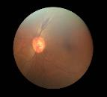
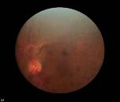
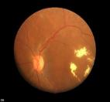
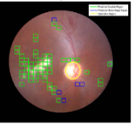





Application in Diabetic Retinopathy
Big Data and Artificial Intelligence
Healthy
DR: Red lesions
DR: Yellow lesions
Employed Convolutional neural network (a type of deep learning approach), to automatically extract features using a series of filters.
Take image with fundus camera and send it into cloud
Image preparation and processing of algorithms in cloud
Classifi-cation into three classes in cloud
Mark regions of interest for the conditi-ons
Key benefits
Manage scale of users
Algorithm approach
Algorithms
Reduce the demand for experts
Leverage of RB-competencies in deep learning algorithms
100,000 images with Bosch repository focused on improving algorithm performance
Clinical trials completed and status published (link)
Benchmarking with existing Start-ups to assure leadership
Diabetic retinopathy
Glaucoma
Dry Eye condition (Interpretation of oil secreting glands in eye lid)
Reduce manual errors
Improved turn around time
Current status of sensitivity >90%, variability in image quality still challenging
Enable digital healthcare

Slide 10

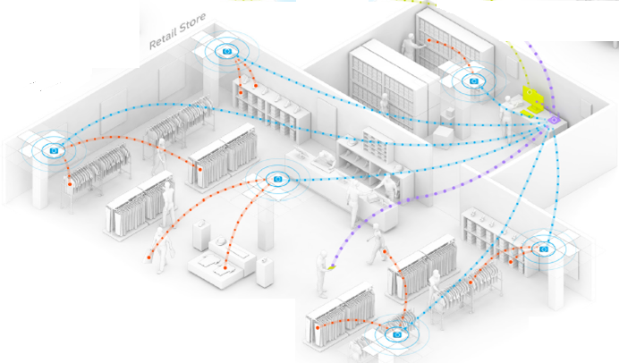








Automated Store Management: AI Solution utilizing Vision and RFID Data
Big Data and Artificial Intelligence
Computer Vision, RFID and Machine learning are used to determine the possible misplacement of items inside the store
Objective
Automated process of detecting
misplaced items in the store,
without manual intervention.
Data
(i) Electronic Product Codes (EPCs), associated with RFID tags placed on them; (ii) Stereo cameras to capture images of all parts of store
Outcome
During store’s operational hours,
misplaced items are automatically detected at regular time intervals
Store with RFID readers and stereo cameras placed on ceiling
Retail stores have scope for using analytics to help in automation of their processes, wherein manual intervention can be avoided.
Blob Analysis – Detection and Tracking of Human object movements across the store
Track & Map – Mapping of items picked up by the Human object using RF/BT Analytics & CV
Auto Check-out & Billing – Detection of customer entry & exit. Automatic assignment of item to customers
Future fusion with additional sensor data for automated inventory management, improved store planning and visual merchandising recommendations
Application of advance tech. such as Computer Vision, Machine learning and RFID analytics to build a self learning system

Slide 11
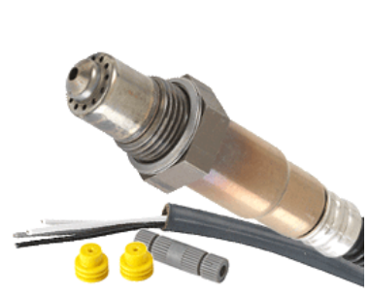
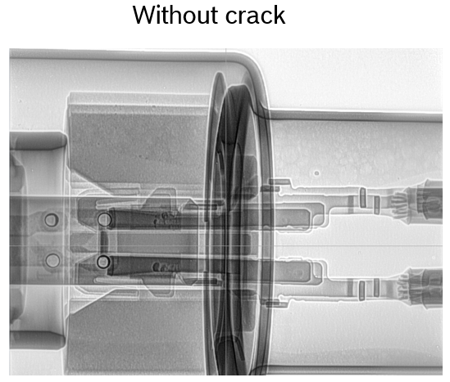
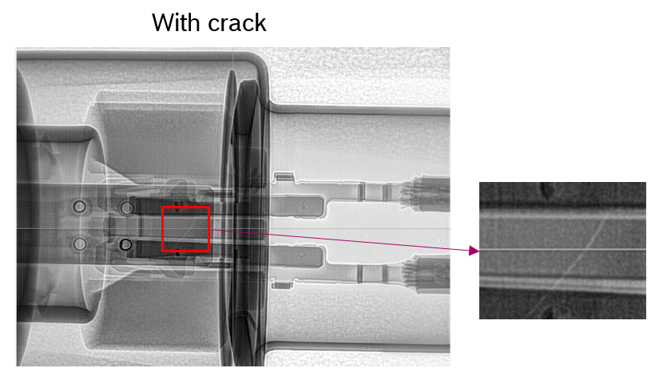
Crack detection of a sensor (O2 Lambda Sensor)
Big Data and Artificial Intelligence
Objective | Analyze X-Ray images of a sensor to determine the cracks
Approach | Deep Learning
Motivation | Improvement in quality check Identify cause for failures
Notes:
Lamda Sensors are used to sense the amount of O2 in the exhaust pipes of vehicles. Finding out cracks on Zirconium element because it fragile (like glass). End of line module for Visual Inspection for automated QC

Slide 12
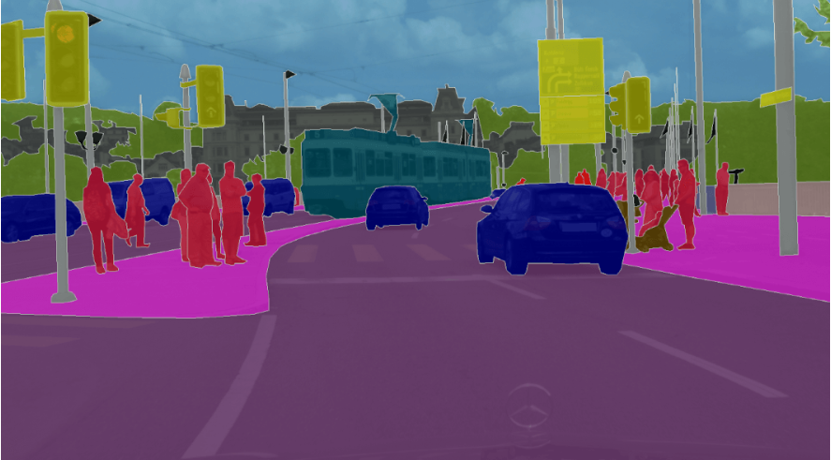
Automotive uses-cases
Big Data and Artificial Intelligence
Object Detection
Segmentation
Tracking
Classification
2
1
Pre-label correction modes
3
Semi-automatic labelling with Watershed brush
Enabled Pixel Labelling with freehand tools
Uncertain region Visualizations
4
Other Key feature additions | visualizations | workflow refinements
Smart contour tool Integration
One mode Fusion – Layered Segmentation
7
5
6

Slide 13
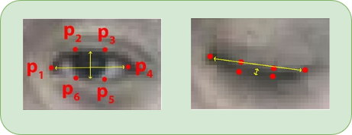
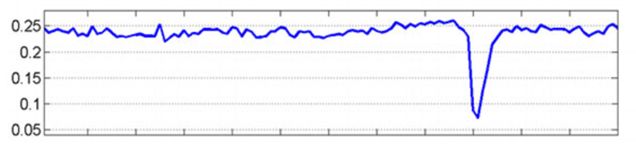
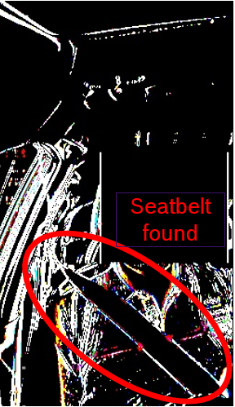
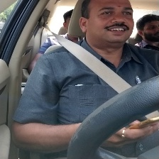
In-Car Entertainment & Safety
Big Data and Artificial Intelligence
Attention
Distraction
Safety
+

Slide 14
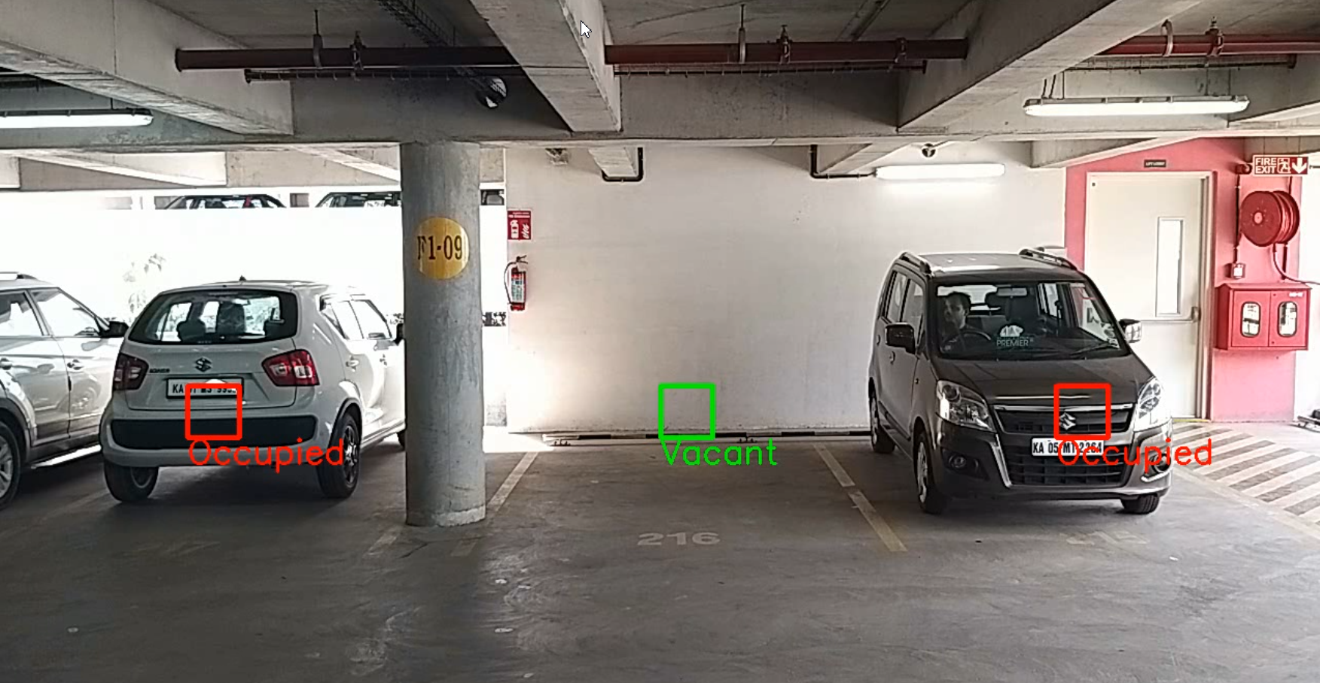
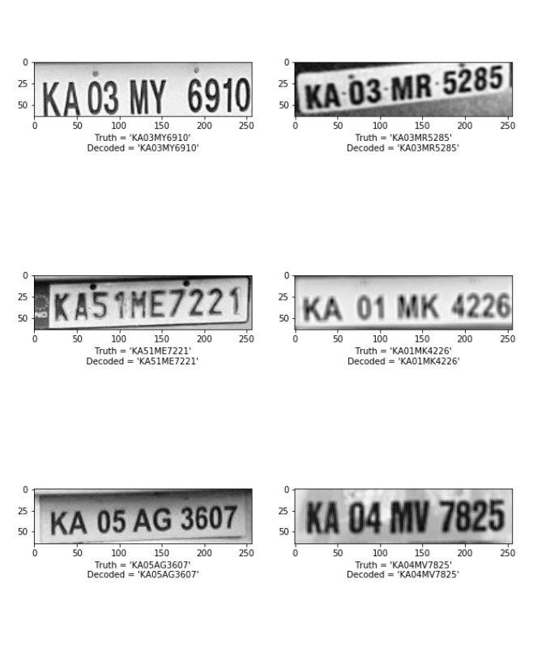
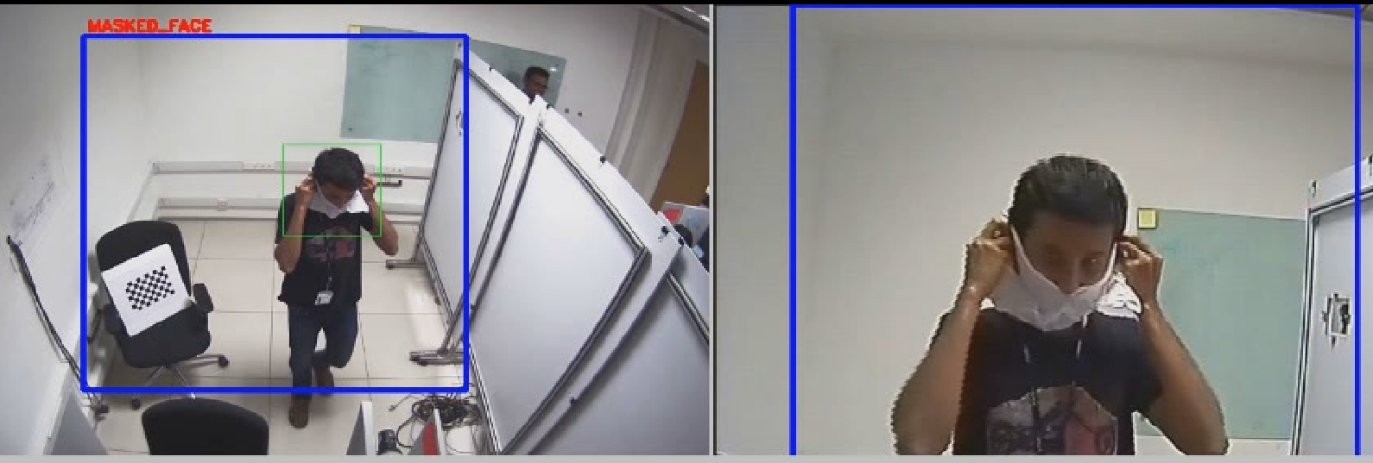
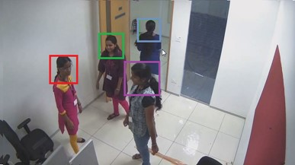
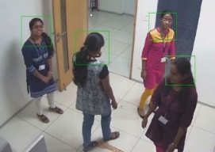
Infrastructure, Urban Planning
Big Data and Artificial Intelligence
Parking Management
ANPR
Security & Surveillance
Masked Face Anomaly Detection
Head neck Tracking and Unique ID Assignment

Slide 15
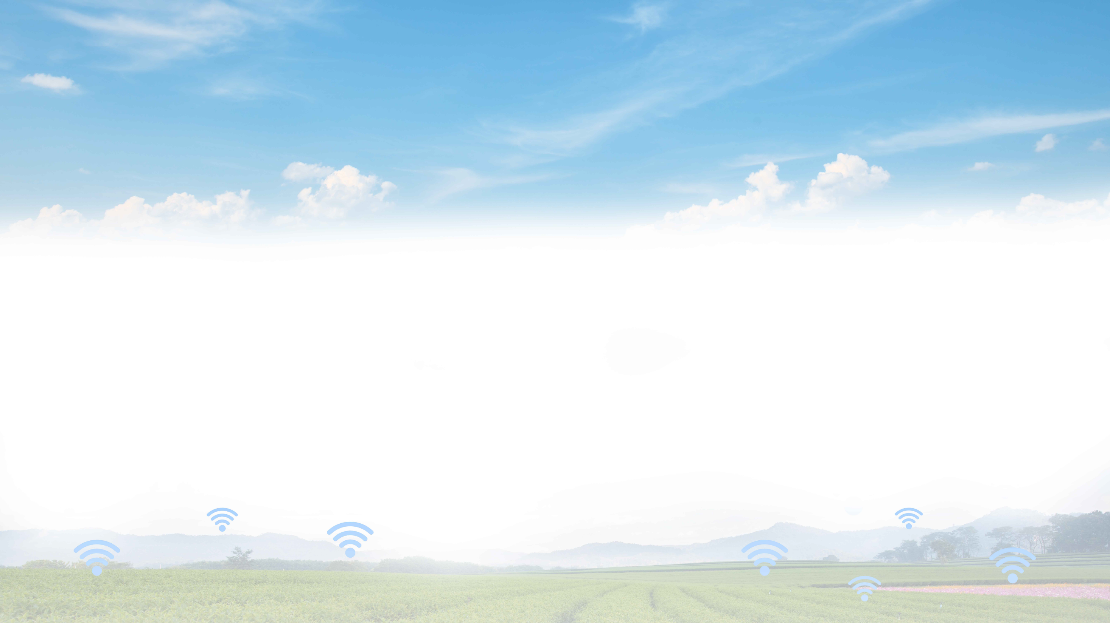
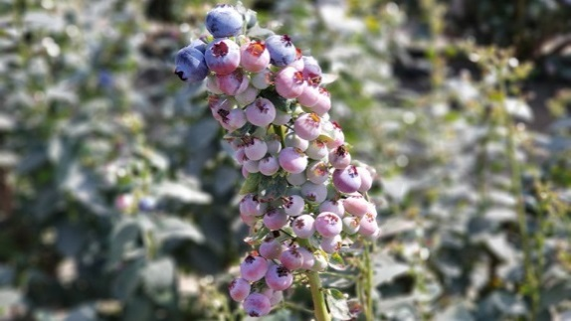
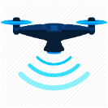







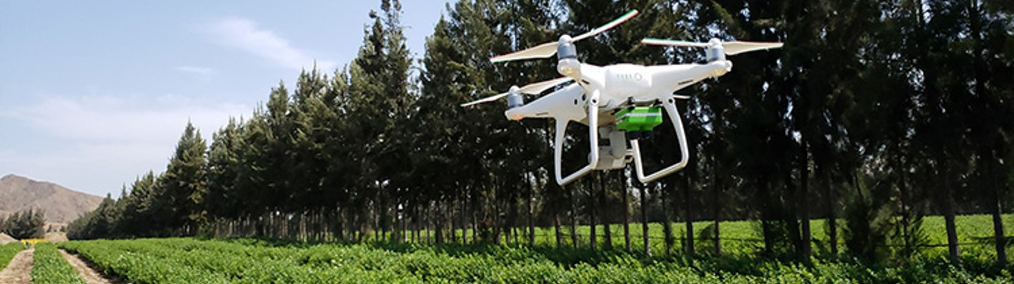


Drone-based image analytics: blueberry counting
Big Data and Artificial Intelligence
Smart image analytics solution to better estimate harvest dates and volume
Situation
Benefits
Drone
Computer Vision
Deep Neural Network
Statistical &
regression models
Complete visibility of the health of the crop
1800 hectares farm employs close to 12000 workers to manually harvest the berries
Stage Classification
(7 stages in Blueberry life cycle)
Climate
Humidity
Environmental factors
Real-time Data Acquisition
Berry-cluster localization
Berry count derivation
Production Volume Estimation
Use technology to better estimate harvest dates and volume of the harvest
Precision Farming
Competitive farming
Life cycle of a blueberry goes through 7 different stages and lasts 87 days
Scalable smart platform and sensor infrastructure for remote farm monitoring

Slide 16

Thank You
Thank You Thank You

